Slide 1
CERN Computing Platforms for Multi-Disciplinary Research
DKE-DS - Maastricht
Alberto Di Meglio
23/06/2017

Slide 2
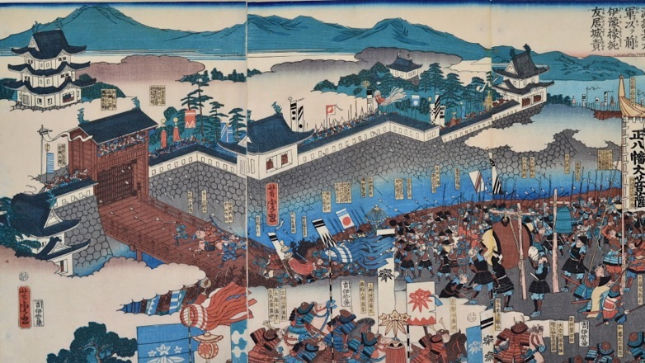
CERN and High-Energy-Physics (HEP) Research
Attacking a Castle - Utagawa Yoshitora (active 1840-1880) c.1864. Oban Triptych.

Slide 3
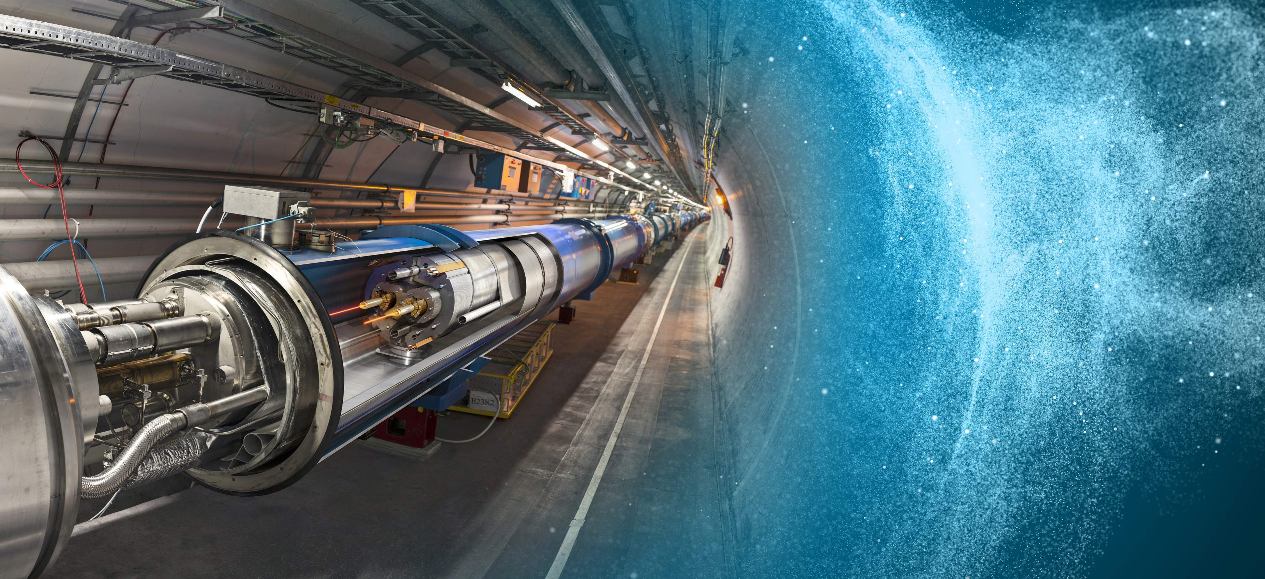
CERN: A UNIQUE ENVIRONMENT
Pushing technologies to their limits to enable scientific research

Slide 4
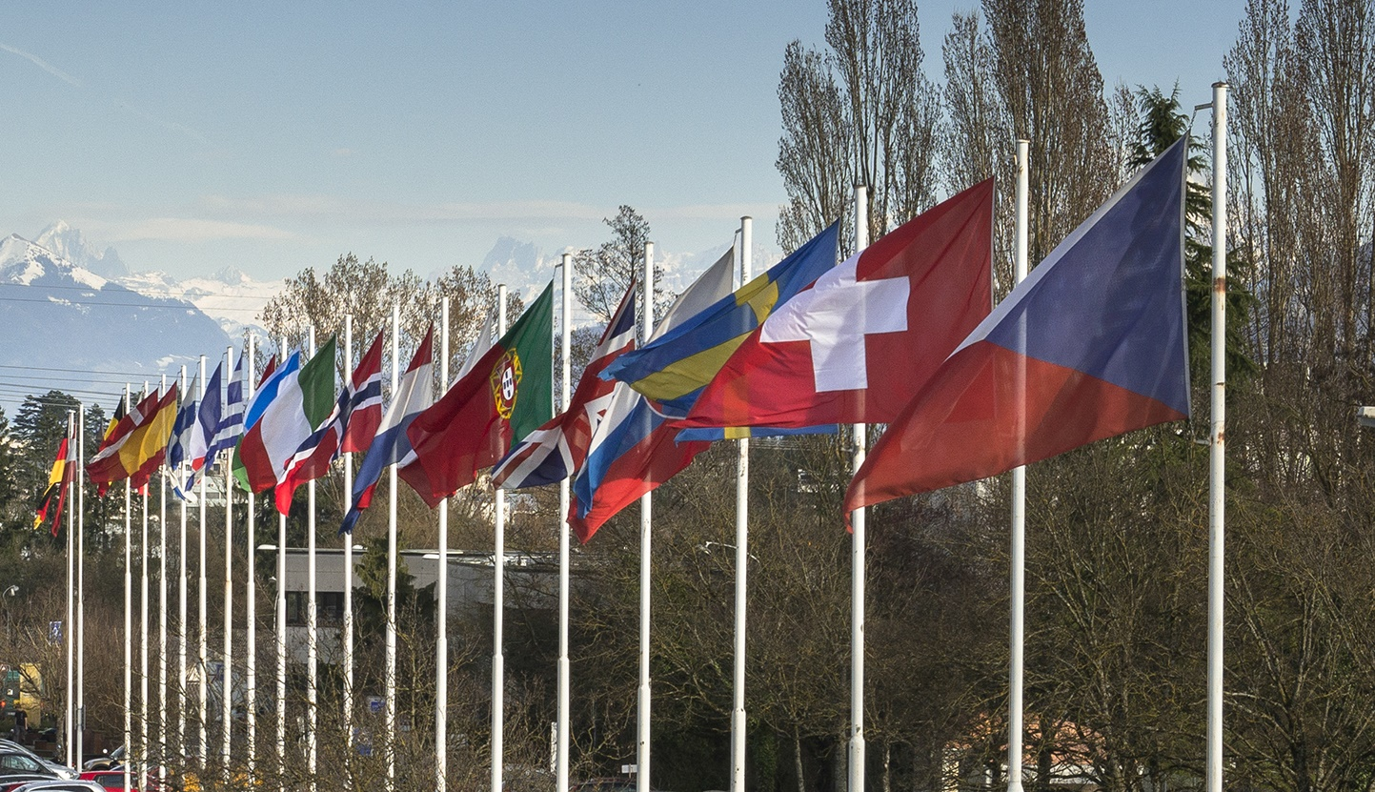
WHAT IS CERN?
European Organization for Nuclear Research
Member States:
Austria, Belgium, Bulgaria, Czech Republic,
Denmark, Finland, France, Germany,
Greece, Hungary, Israel, Italy, Netherlands, Norway,
Poland, Portugal, Romania, Slovakia, Spain, Sweden,
Switzerland and United Kingdom
Associate Members in the Pre-Stage to Membership:
Cyprus, Serbia
Associate Members:
India, Pakistan, Turkey, Ukraine
Observers to Council:
Japan, Russia, United States of
America, the European Commission, Joint Institute for
Nuclear Research and UNESCO
~ 3 000 members of personnel
~ 12 000 users
Budget ~ 1 100 MCHF per year
FOUNDED IN 1954

Slide 5
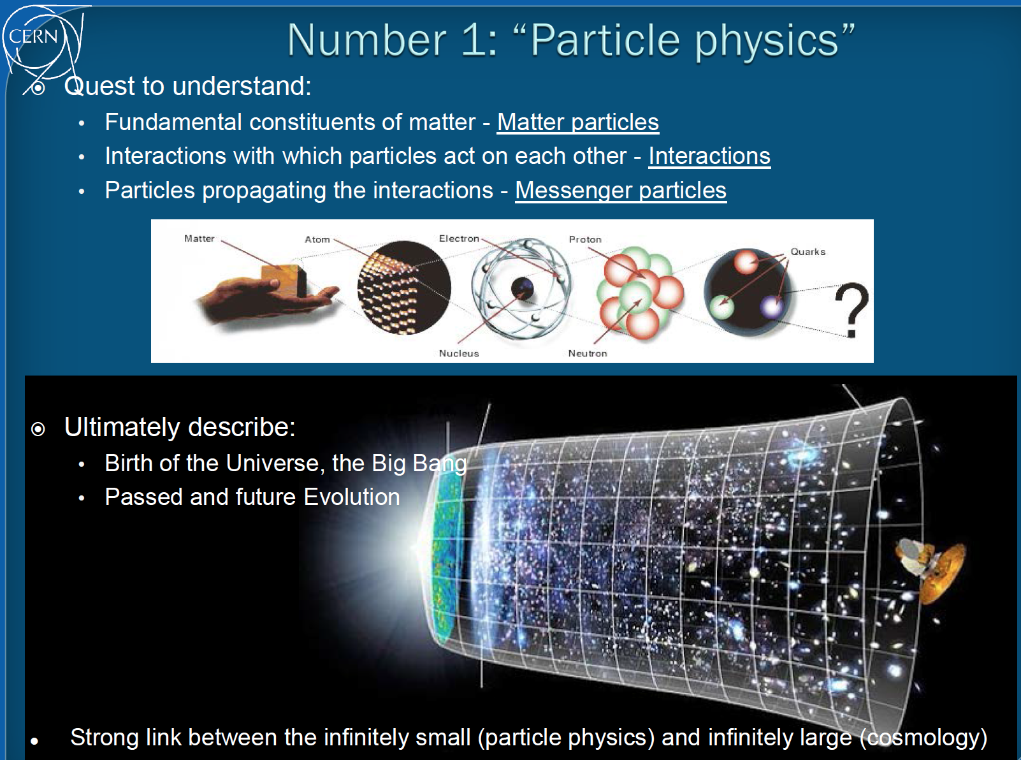
xx

Slide 6
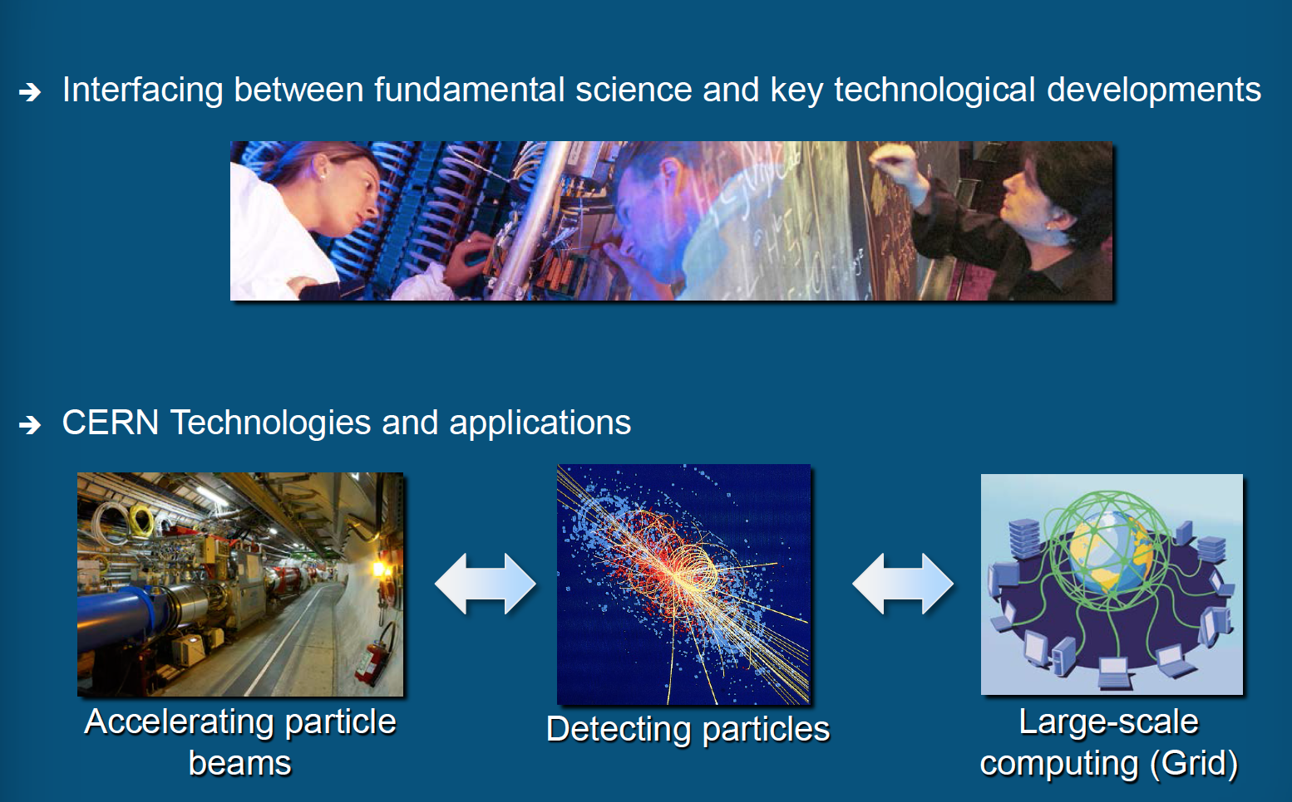

Slide 7
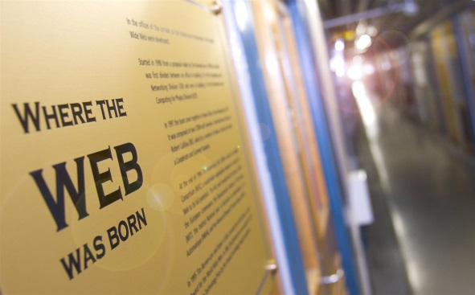
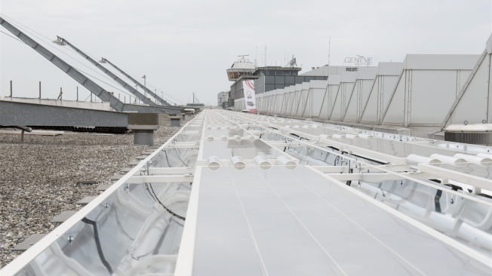
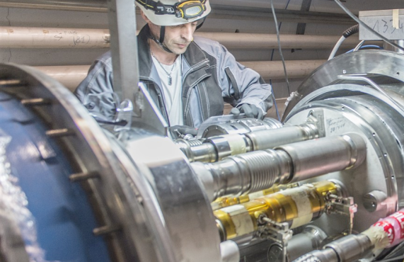
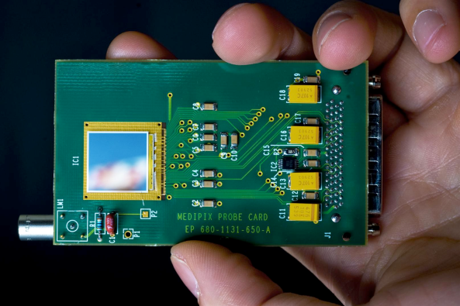
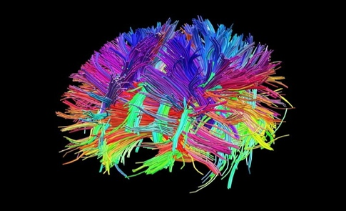
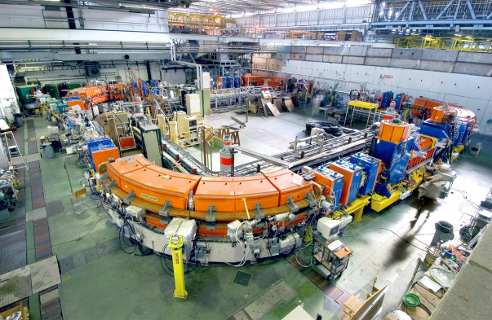
Science and Innovation at CERN
The World Wide Web
High-Efficiency
Solar Panels
Mechanical Eng.
Material Science
Radiation Sensors
Simulation Software
Hadron Therapy

Slide 8
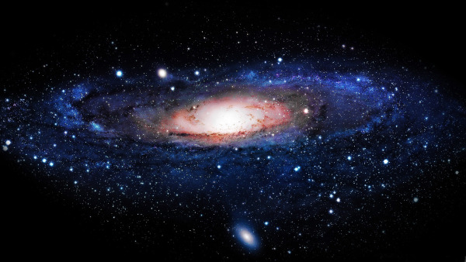
The Higgs Boson completes the Standard Model,
but the Model explains only about 5% of our Universe
What is the other 95% of the Universe made of?
How does gravity really works?
Why there is no antimatter in nature?
Exotic particles? Dark matter? Extra dimensions?

Slide 9
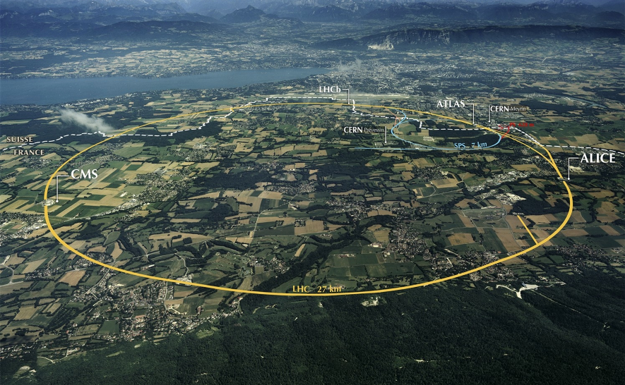
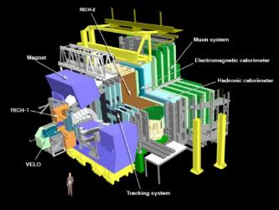
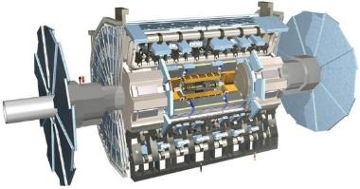
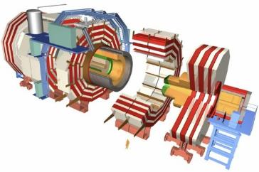
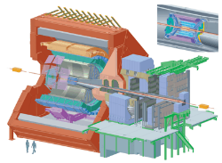
The Large Hadron Collider (LHC)

Slide 10
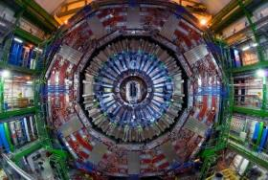
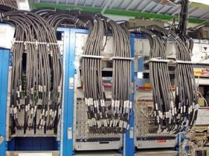
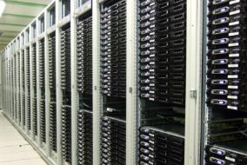
Burning Haystacks
The Detectors: 7000 tons “microscopes”
150 million sensors
Data generated 40 million times per second
➔ Peta Bytes / sec !
Low-level Filters and Triggers
100,000 selections per second
➔ Tera Bytes / sec !
High-level filters (HLT)
100 selections per second
➔ Giga Bytes / sec !

Slide 11
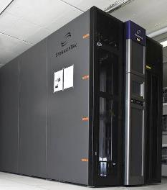
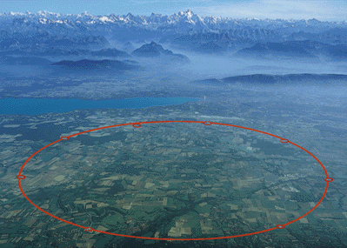


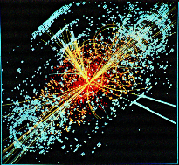



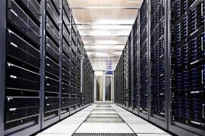
Storage, Reconstruction, Simulation, Distribution
260 GB/s

Slide 12
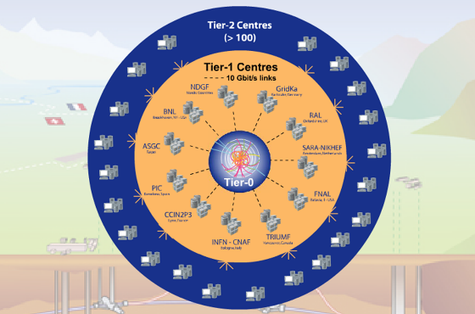
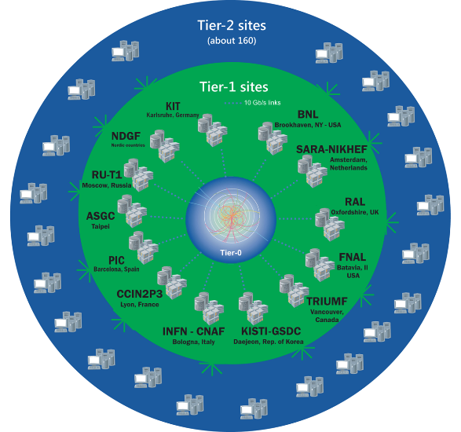
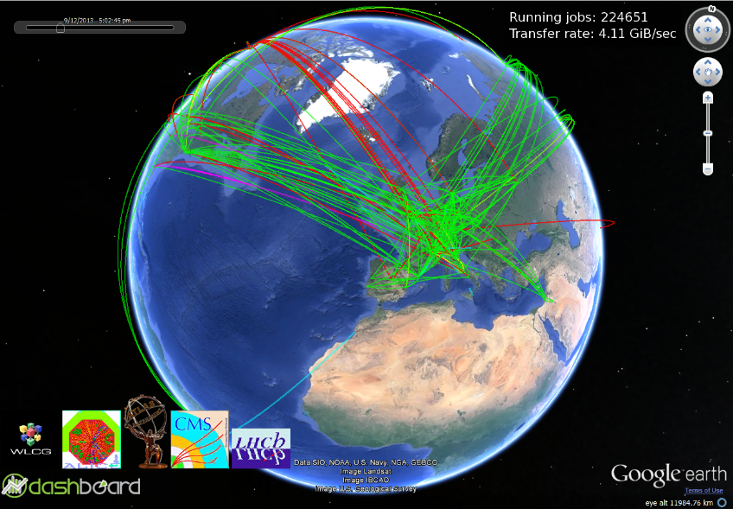
Worldwide LHC Computing Grid
Tier-0 (CERN):
Data recording
Initial data reconstruction
Data distribution
Tier-1 (14 centres):
Permanent storage
Re-processing
Analysis
Tier-2 (72 Federations, ~149 centres):
Simulation
End-user analysis
660,000 cores
690 PB

Slide 13
CERN Colliders Programme

Slide 14
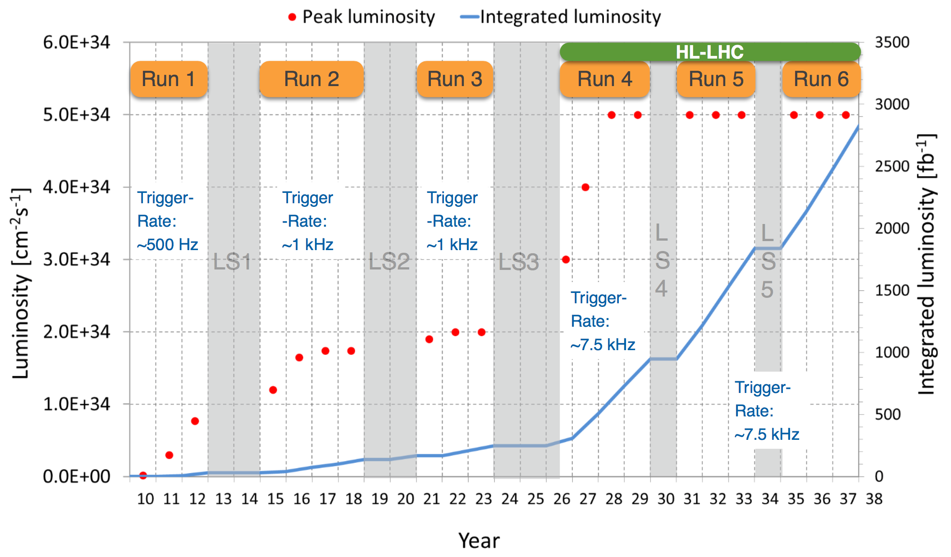
LHC Schedule

Slide 15
LHC Run3 and Run4
Scale and Challenges
2009
2010
2011
2012
2013
2014
2015
2016
2017
2018
2019
2020
2021
2022
2023
2024
2025
…
2030?
…
First run
LS1
Second run
LS2
Third run
LS3
HL-LHC
FCC?
Raw data volume for LHC increases exponentially and with it processing and analysis load
Technology at ~20%/year will bring x6-10 in 10-11 years
Estimates of resource needs at HL-LHC x10 above what is realistic to expect from technology with reasonably constant cost
Data:
Raw 2016: 50 PB → 2027: 600 PB
Derived (1 copy): 2016: 80 PB → 2027: 900 PB
CPU:
x60 from 2016
    Technology revolutions are needed

Slide 16
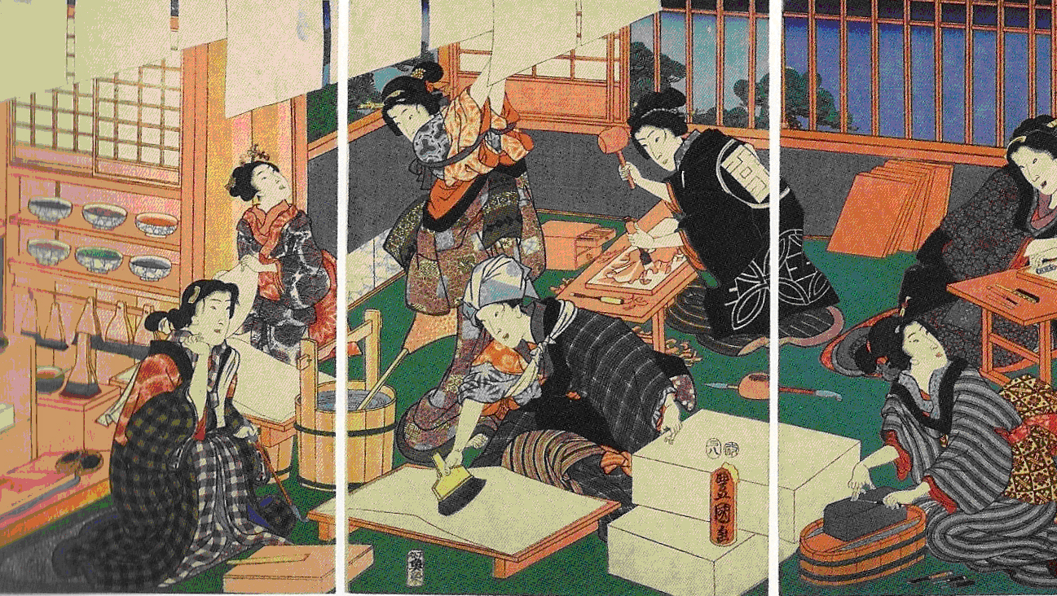
Big Data Technology
CERN openlab
Artisans – Utagawa Kunisada, 1857 – British Museum -- CC BY-NC-SA 4.0
Artisans – Utagawa Kunisada, 1857 – British Museum -- CC BY-NC-SA 4.0

Slide 17
CERN OPENLAB’S MISSION
Our recipe for success
• Evaluate state-of-the-art technologies in a
challenging environment and improve them.
• Test in a research environment today
technologies that will be used in many business
sectors tomorrow.
• Train the next generation of
engineers/researchers.
• Promote education and cultural exchanges.
• Communicate results and reach new audiences.
• Collaborate and exchange ideas to create
knowledge and innovation.

Slide 18
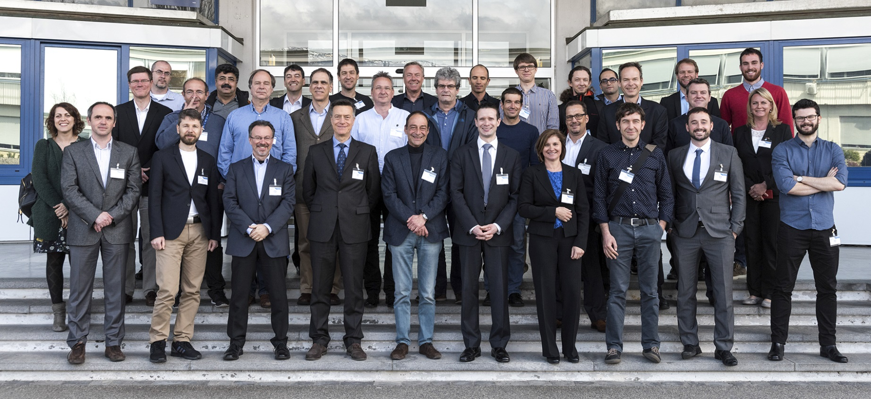
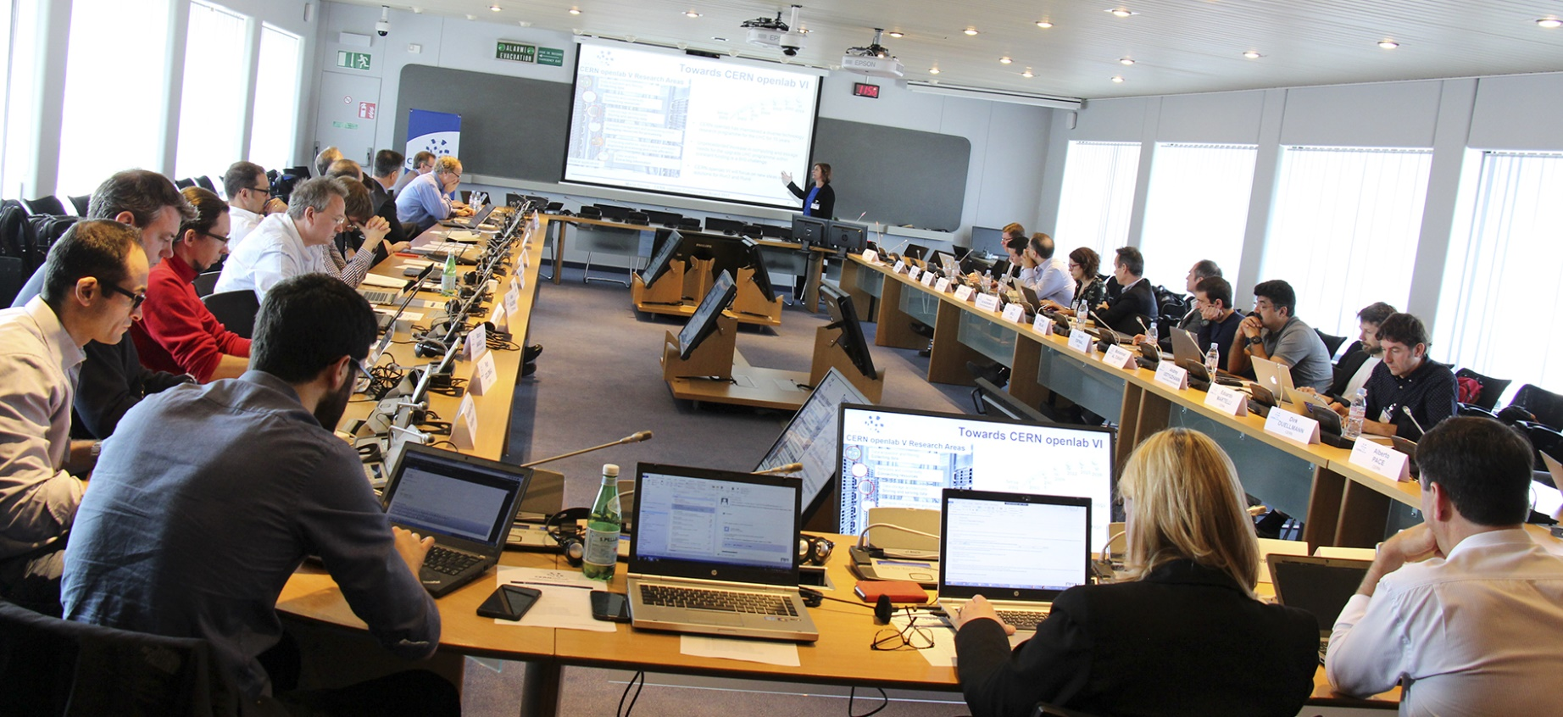
DRIVING INNOVATION SINCE 2001
Entering our sixth three-year phase
CERN openlab Collaboration Board 2017

Slide 19
COLLABORATION MEMBERS
A public-private partnership between the research community and industry

Slide 20
ICT RESEARCH AREAS
Tackling tomorrow’s ICT challenges today
Data acquisition and filtering
Collecting data
Compute management and provisioning (cloud)
Managing resources for processing
Networks and connectivity
Connecting resources
Computing platforms, data analysis, simulation
Improving processing and code efficiency
Data storage architectures
Storing and serving data
Data analytics and Machine Learning
Extracting information

Slide 21
Data Centre Technologies
Increase capacity and resource availability (for the same cost!)
  Exploit new trends in resource disaggregation
  Optimize usage pattern through analysis of sensor data (end-to-end)
Push virtualization and “containerization”
  To automate provisioning and standardization
  As much as possible without compromising (too much) performance
Invest in Software Defined Infrastructure (SDI) and Network (SDN)
  To optimize resource allocation, network traffic, security

Slide 22
Infrastructure
Storage
  Increase capacity for the same or less EUR/MB
  Investigate new disk and NVRAM technology (ex. Intel 3D-Xpoint)
  Arbitrarily software-configurable QoS for different workloads
Cloud Computing
  On-premise virtualization/containers based on OpenStack
  Seamless scale-out with public providers without impact on users
Networks
  Very-high bandwidth (100s TB/s) transfers from experiments to main DC
  Impact of emerging IoT applications, 5G multi-protocol architecture

Slide 23
Computing and Software
Refactor/redesign software
  Exploit the potential of multi-core, manycore platforms
  Takes a lot of effort and skills!
Heterogenous computing platforms
  Balance GP and specialized platforms (GPUs, FPGAs, ML-optimized)
  Optimize allocation of workflows
The possibility of using VMs/Contaners and automation is critical
  HPC in the Cloud

Slide 24
Machine Learning
Physics Research
  Fast data reduction
  Fast ML-assisted physics processes simulation
Engineering
  Predictive maintenance of the LHC Accelerators complex
  Anomaly detection (magnets, cryogenic systems, power systems, etc.)
ICT infrastructure
  Optimization of data transfers, pre-emptive allocation (consensus or trend-based)
On-Demand DA/ML service
Evaluation of specialized hardware (GPUs, FPGAs), cloud services

Slide 25
KNOWLEDGE SHARING
Working with communities beyond high-energy physics
Working closely with research institutes worldwide on initiatives aimed at sharing tools, skills, and knowledge between the high-energy physics community and other research fields.
Examples of ongoing projects related to biomedical research (Intel involved).
BioDynaMo
Developing a cloud-based platform for modelling biological development.
GeneROOT
Using ROOT to analyse and share large genomic data sets and pipelines.
BigHealth
Integrating health data from diverse sources for systems-biology studies.

Slide 26
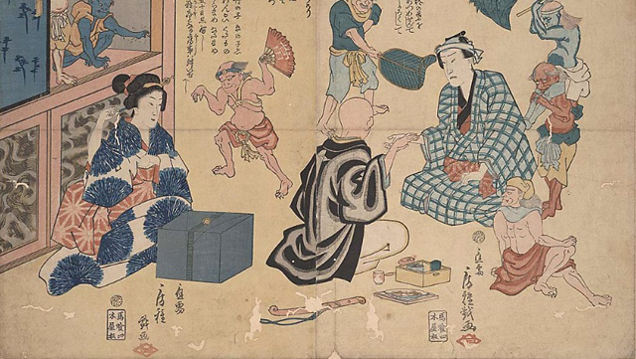
“Big Data” and Multi-Disciplinary Distributed Research Platforms
Methods for preventing measles - Utagawa Fusatane, 1858 -- UCSF Japanese Woodblock Print Collection

Slide 27
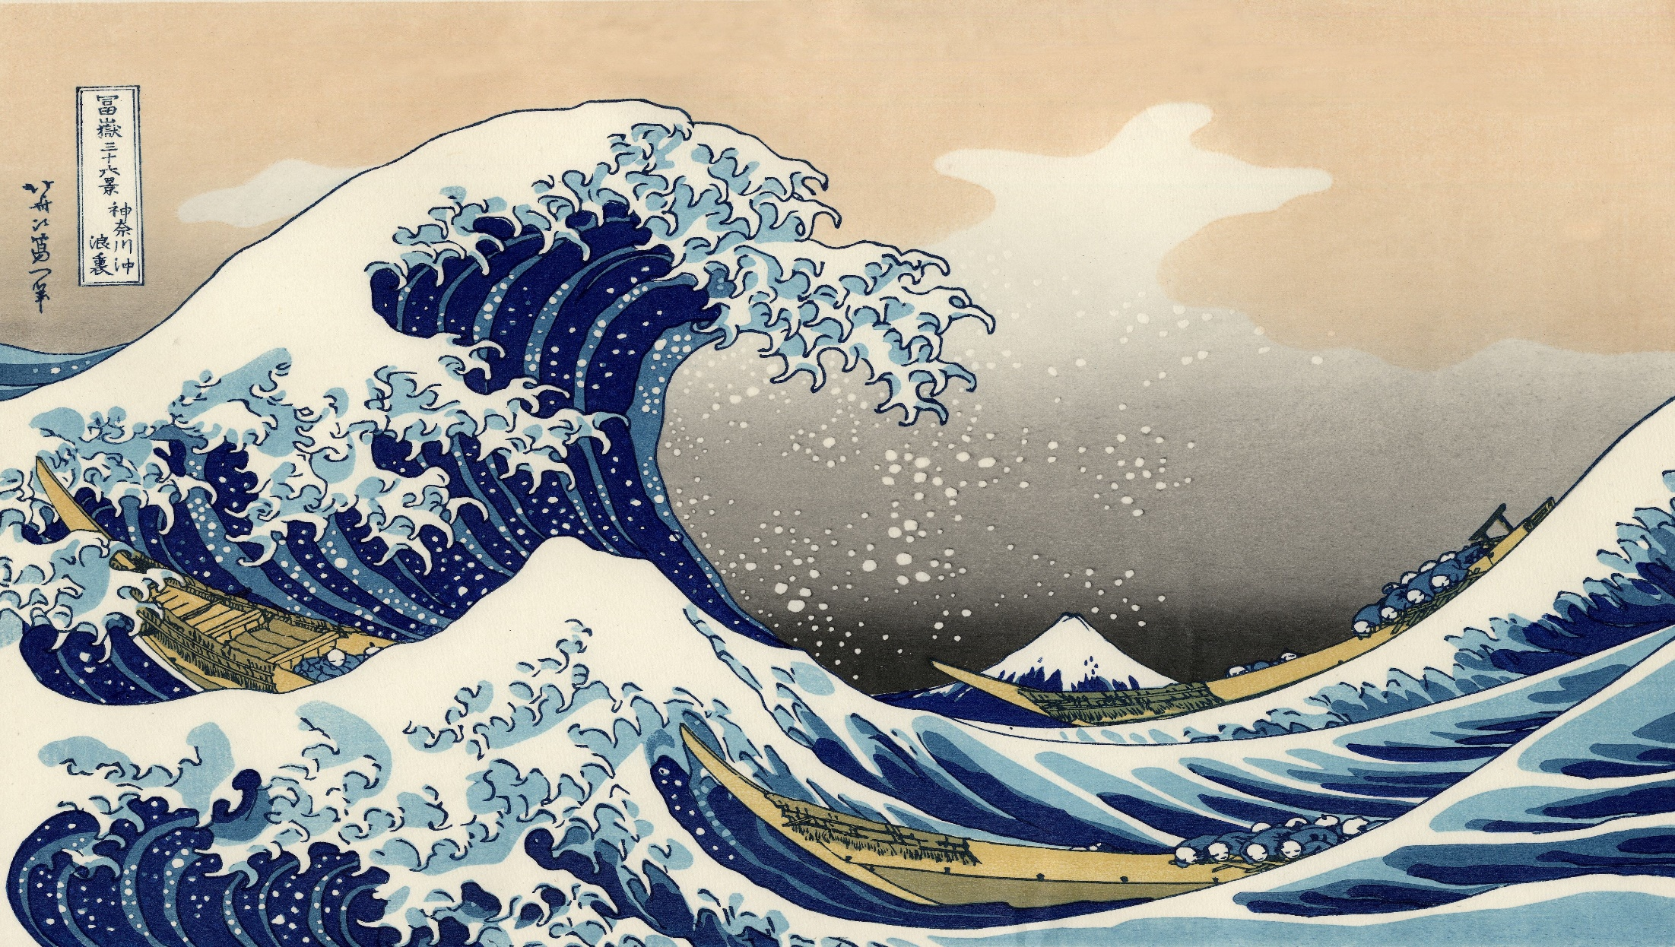
Value
Veracity
Variability
Variety
}
3-V Definition
Velocity
Volume

Slide 28
It’s all about Data
Big > ~10s of TB over a (your-definition-of) short period of time
Slow/Fast is not an absolute value
Local/Distributed: cost and logistics of (secure) data storage and transfers
Public/Private: most characterizing property of healthcare applications
Legacy: not only the data itself (format), but how it is stored and accessed (Excel, SQL, etc.)
Unstructured ~ 80% (estimated)
Stand-alone/Shared is about interoperability and standards compliance
Store/Reproduce: how much must be stored, for how long, how much can be reproduced? Not the same as Raw or Processed data

Slide 29
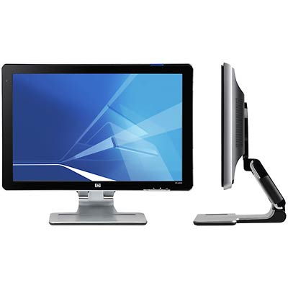
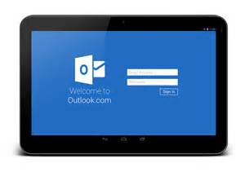
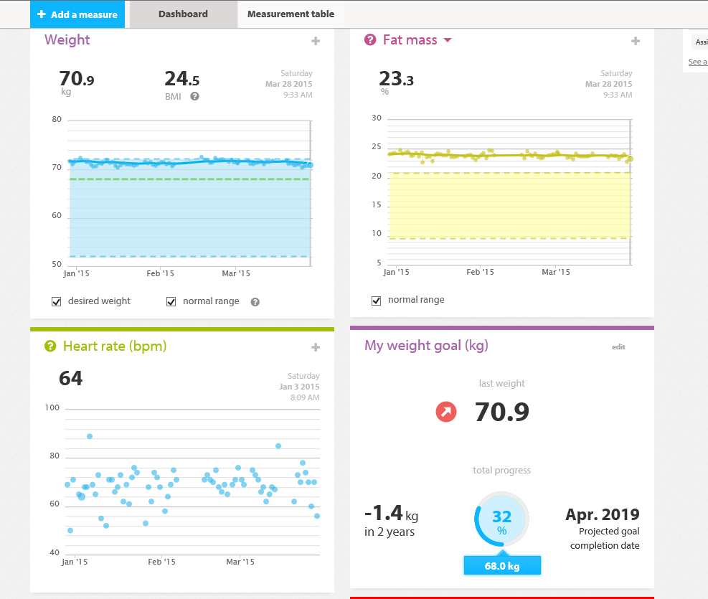
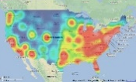
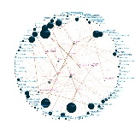
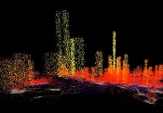
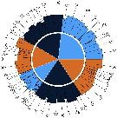
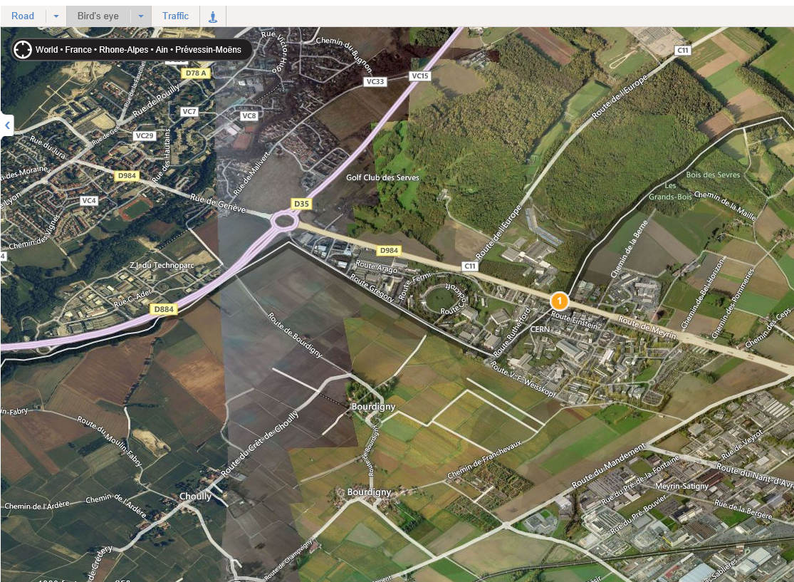

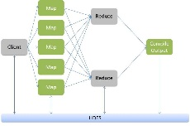

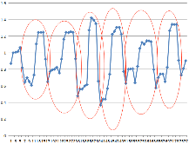
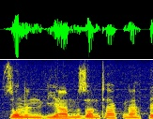


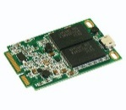
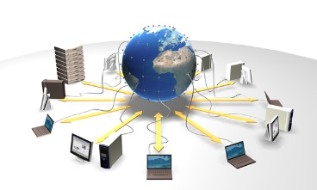
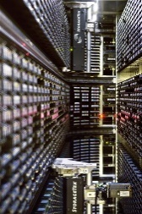
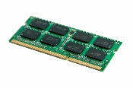
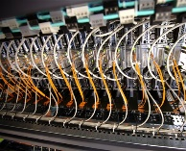

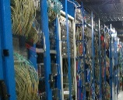


Information
Information
Applications designed
for “big data”
Software
Data visualization,
representation
Value
Veracity
Variability
Variety
Volume
Velocity
Data analysis
and analytics platforms
Pattern recognition, NLP
machine learning, predictive analytics
Platform
Large storage (disks, tapes, memory)
Distributed Computing and Data Grids, Clouds, HPC, Crowd Computing
Infrastructure
Fast data acquisition systems
Flexible networks

Slide 30

Open Science Clouds
The objective of CERN’s participation in the work programme is to develop policies, technologies and services that can support the Organization’s scientific programme, promote open science and expand the impact of fundamental research on society and the economy.
European Open Science Cloud can provide the context for future projects
However, a major question remains:
how to really make it accessible and usable by scientific communities at large

Slide 31

Ecosystem Effect
The Garden as a Metaphor for Platforms
Concerts, games, suggestion box
(Events, feedback)
People walking, playing, fishing
(Large communities)
Kiosks
(Third-party services and extensions, Marketplace)
Opening and closing times, don’t walk on the grass, no fishing on Tuesdays
(Policies)
How many people came today? What did they do?
(Statistics, trends, predictions)
The Mayor
(Funding Agencies)
Park manager, guards
(Governance)
Different plants and flowers
(Commodity services)
Insects and animals
(Small communities, micro services)
Seeds
(Pilot projects)
Sellers of fertilizers, equipment, furniture, electricity, water
(Infrastructure providers)
Weeds
(Failed projects)
Gardeners, botanists
(Technical experts)

Slide 32
Platforms as Enablers of Ecosystem Effects
As scale grows, a sound digital ecosystem is generated by four main elements and a way for those elements to interact on common terms
Platforms are the unifying services at the intersections that enable
commoditization
best practices
aggregation and integration
share and reuse of data
reproducibility
collaborations, etc.
Community
Practice
Platforms
Content
Technology
Digital
Ecosystem

Slide 33


Slide 34

Platforms Layers
= Open, standard Interfaces
Apps
Apps
Interactive UIs, Notebooks (Jupyter, Azure ML Studio, etc.)
Distributed digital object repositories (publications, datasets, software)
Orchestration
Data Analysis as a Platform
(Root, MAPR, cloudera, elastic, Microsoft HDI, Amazon QS, Oracle Analytics, etc.)
Simulation as a Platform
(many academic examples, CloudMC, Schneider)
Machine Learning as a Platform
(SparkML. Amazon ML, Microsoft ML, IBM Watson, BigML, DataRobot, FICO, Yottamine, etc.)
Storage back-end (on-premise, cloud storage, standard APIs)
Cloud (hybrid on-premise/public, OpenStack, HNSC, EGICLoud, commercial providers, etc.)

Slide 35
End-to-End Architecture
Applications
CERN Apps
Community X
P
a
a
S
Platforms
ROOT, Geant V, Zenodo, OD-DA/ML, SWAN
Collaborative Platform Services
Hadoop, Spark, etc.
I
a
a
S
Computing
Storage
OpenStack, CERNVM,
Boinc
EOS,
CVMFS
Helix Nebula
European Science Cloud
Other EC-funded initiatives
Cloud

Slide 36








Codename: SCORPIUS
Scalable COllaborative Research Platform for Interactive USage
Founding Members:
CERN
King’s College London (Dep. Twin R&GE)
SIDRA Research Centre (Qatar)
Intel
Design and implementation of an architecture-neutral, large-scale genomic research collaborative platform
Cloud backend able to ingest and aggregate different types of data and formats, support for public and private data
Emphasis on ease of installation, reproducibility, sharing through citable containers and VEs
Best-of-Breed UX with support for AI-based data search and retrieval, text-mining
Current status: Prototype, focus on benchmarking of different tools for CNV discovery
Seeking collaborations: developers, domain experts, testers, use cases
Best Practices
Data Banks
Code
Publications
Methods and Pipelines
AI-assisted Data Extraction, Aggregation, Validation
Citable Containers, Virtualized Environments

Slide 37








Codename: BioDynaMo
Biology Dynamic Modeller
Founding Members:
CERN
Newcastle University (Neuroinformatics Institute)
Innopolis University
Kazan University
Intel
Design and implementation of an architecture-neutral, large-scale biological development simulation platform
Cloud backend able to dynamically scale or shrink with the simulated model
Integration and sharing of experimental data (e.g. functional MRI images), textual publications, models, results
Cheaper to operate compared to more sophisticated HPC solutions and more expandable
Current status: Prototype, initial development of a software stack optimized for multi-core architectures
Seeking collaborations: developers, domain experts, testers, use cases
Sharing models
and results
Project definitions
Experimental data and publications

Slide 38

Working at CERN
Basket-fishing in the Kinu River, Hokusai, 1833. Ukiyo-e print, 18.3 x 25.4 cm. Museum of Fine Arts, Boston

Slide 39

https://jobs.web.cern.ch/content/working-cern

Slide 40
Profiles and Programmes
Not many physicists work for CERN (at least not as researchers)
  Most researchers come as part of the Experiment collaborations
  CERN personnel is composed of engineers, computer scientists, technicians, software developers, mathematicians, accountants, communication experts, technical writers, biologists,…
The typical profiles and career paths are (but there are many variations):
  Summer/Technical/Admin Student: from 2 to 14 months
  Fellow: from 12 to 36 months
  Doctoral student: 36 months
  LD Staff: up to 8 years
  IC Staff
Any profile can be accessed directly subject to eligibility conditions (degree, nationality, etc.) except IC (with exceptions…)
IC positions are very limited and competitive

Slide 41

Education and Training
Training tomorrow’s leaders in ICT

Slide 42
General Education Programmes
Many interesting educational programmes
  High-school stages and seminars
  Trainees
  Technical/Admin Students (count as university training period for the award of the final BSc/MSc degree)
  Doctoral Students (fully or partially spent at CERN)
  CERN School of Computing (CSC): very competitive, but very rewarding
  Summer Students Programmes (Physics and IT/Computing)

Slide 43


CERN openlab Summer Students Programme
  In 2016
  1480 applicants
  39 selected students
  14 lectures
  Visits to external labs and companies
  Lightning talks session
  39 Technical reports
  In 2017
  1580 applicants
  37 proposed projects

Slide 44





2017 Intel® Modern Code Developer Challenge
CERN openlab – Intel Summer Students Collaborative Challenges
Challenge 1
Smash-simulation software
Challenge 2
Connecting the dots
Challenge 3
Cells in the cloud
By Marc Vidal - Own work, Wikimedia Commons (CC BY-SA 4.0).
Challenge 4
Disaster relief
Artificial Intelligence
Image Analysis
Code Modernization
HPC in the Cloud
Internet of Things
Challenge 5
IoT at the LHC
Image courtesy of UNOSAT.

Slide 45

QUESTIONS?
alberto.di.meglio@cern.ch
Twitter: @AlbertoDiMeglio

Slide 46

CONTACTS
ALBERTO DI MEGLIO
CERN openlab Head
alberto.di.meglio@cern.ch
ANDREW PURCELL
CERN openlab Communications Officer
andrew.purcell@cern.ch
MARIA GIRONE
CERN openlab CTO
maria.girone@cern.ch
FONS RADEMAKERS
CERN openlab CRO
fons.rademakers@cern.ch
KRISTINA GUNNE
CERN openlab Administration/Finance Officer
kristina.gunne@cern.ch
www.cern.ch/openlab

